Slide 1


TELECOM CHURN PREDICTION
SNEHA S J

Slide 2

CONTENTS
Introduction
Our Mission and Vision
Our Goals
Data Cleaning & Preprocessing
ML Model Building
Hyperparameter Tuning
Confusion Matrix
ROC curve
Challenges
Conclusion
SNEHA-S-J/Batch2_Churn_Modeling_On_Telecom_Data (github.com)

Slide 3


INTRODUCTION
Churn prediction in the telecom industry is the process of identifying customers who are likely to cancel their subscription or switch to another service provider. Understanding and predicting customer churn is crucial for telecom companies to retain customers and reduce revenue loss.

Slide 4

OUR MISSION AND VISION
Mission: To leverage advanced analytics and machine learning techniques to accurately predict customer churn, enabling proactive customer retention strategies.
Vision: To be the leading telecom company in customer retention by using data-driven insights to enhance customer satisfaction and loyalty.

Slide 5

OUR GOALS
Enhance Customer Retention: Develop an accurate churn prediction model to identify at-risk customers.
Improve Customer Experience: Implement targeted retention strategies to address the specific needs of at-risk customers.
Increase Revenue: Reduce churn rates to maintain a stable customer base and increase overall revenue.

Slide 6

OUR MILESTONE
Data Collection: Acquiring and cleaning the dataset.
Model Development: Building and evaluating the initial churn prediction model.
Hyperparameter Tuning: Optimizing model performance.
Deployment: Implementing the model in a real-world setting.
Continuous Improvement: Regularly updating the model with new data and refining prediction accuracy.

Slide 7

CHALLENGES
Data Imbalance: Churn datasets often have a higher proportion of non-churn customers, leading to imbalanced data issues.
Feature Selection: Identifying the most relevant features for accurate prediction.
Model Interpretability: Ensuring that the model's predictions are interpretable and actionable for business stakeholders.
Data Privacy: Maintaining customer data privacy and compliance with regulations.

Slide 8
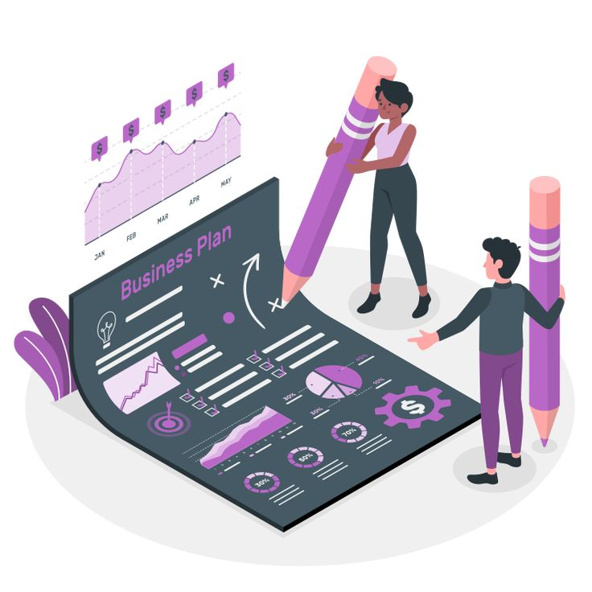
DATA COLLECTION AND PREPROCESSING
Gather relevant data from various sources such as transaction logs, customer service interactions, and usage patterns.
Clean and transform the data to ensure it’s suitable for analysis. This includes handling missing values, encoding categorical variables, and normalizing numerical features.

Slide 9

Feature Selection and Engineering
Create meaningful features that can improve the model's predictive power.
Examples:
Customer demographics (e.g., age, gender, location)
Usage metrics (e.g., frequency, duration)
Interaction history (e.g., customer service calls, complaints)
Transaction data (e.g., purchase history, payment patterns)

Slide 10
Model Building and Evaluation
Logistic Regression:
Suitable for binary classification tasks
Provides probabilistic predictions
Decision Trees:
Easy to interpret
Handles both numerical and categorical data
Random Forests:
Ensemble method that improves prediction accuracy
Reduces overfitting

Slide 11

Model Building and Evaluation
Accuracy:
The proportion of correct predictions
Precision and Recall:
Precision: True positives / (True positives + False positives)
Recall: True positives / (True positives + False negatives)
F1 Score:
Harmonic mean of precision and recall
ROC-AUC:
Measures the trade-off between true positive rate and false positive rate

Slide 12
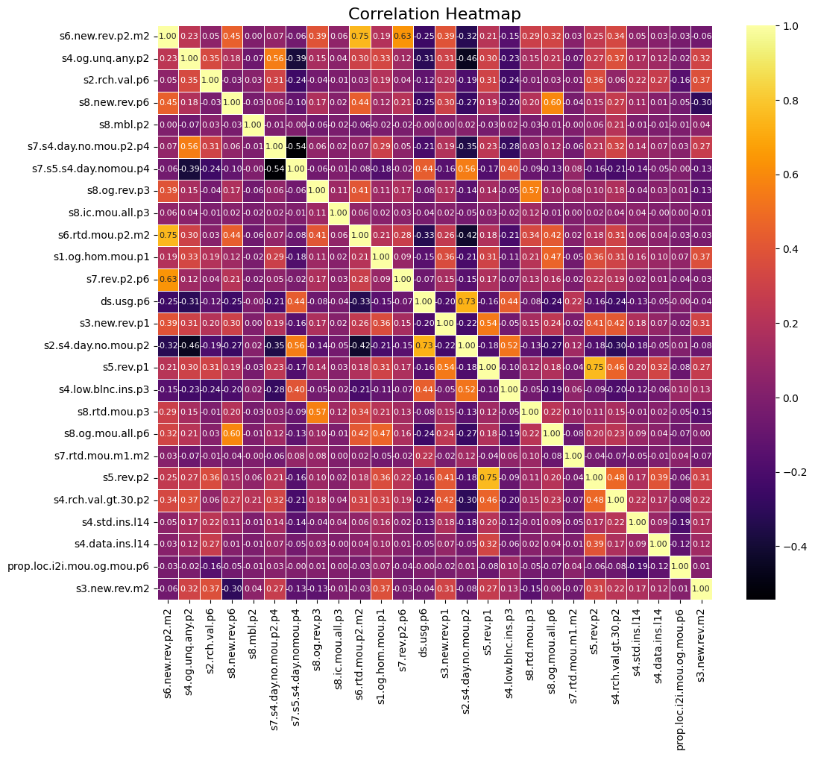
Correlation Matrix
The dataset is divided into training and testing sets. Typically, 70-80% of the data is used for training the model, while the remaining 20-30% is used to test its performance.
The dataset is divided into training and testing sets. Typically, 70-80% of the data is used for training the model, while the remaining 20-30% is used to test its performance.
The selected model is trained on the training dataset. This involves feeding the data into the model and adjusting the model parameters to minimize errors.

Slide 13

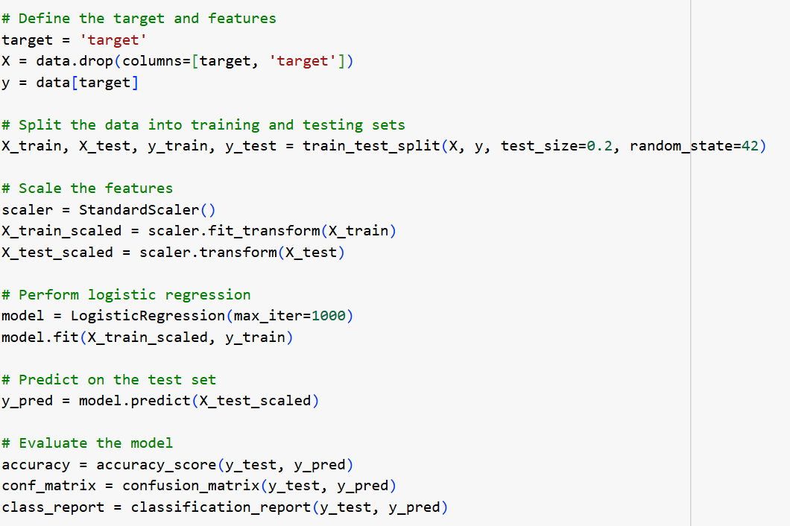

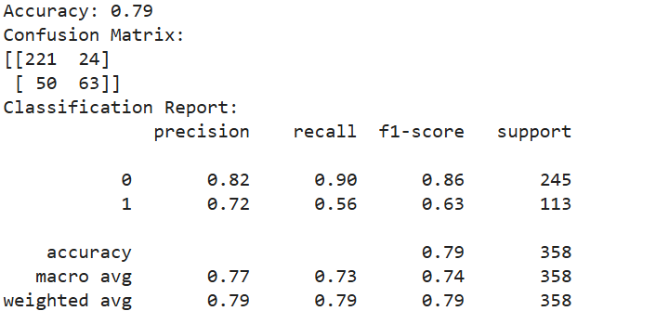
LOGISTIC REGRESSION
A statistical model that predicts the probability of a binary outcome. It is simple and interpretable.

Slide 14
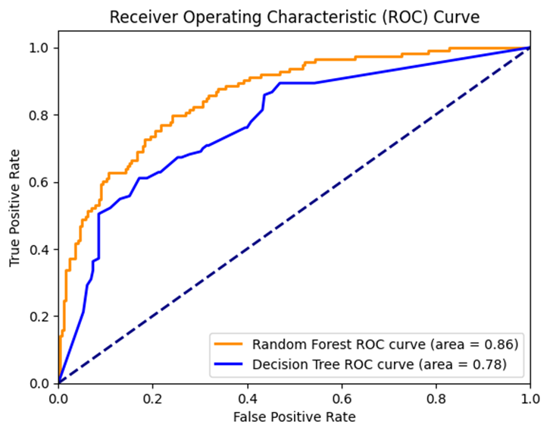
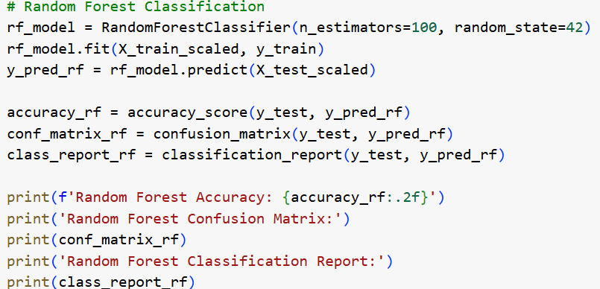
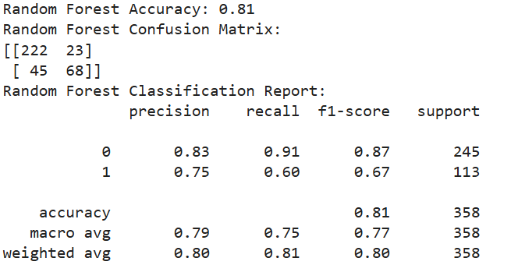
RANDOM FOREST
An ensemble method that builds multiple decision trees and combines their predictions. It improves accuracy and reduces overfitting.

Slide 15

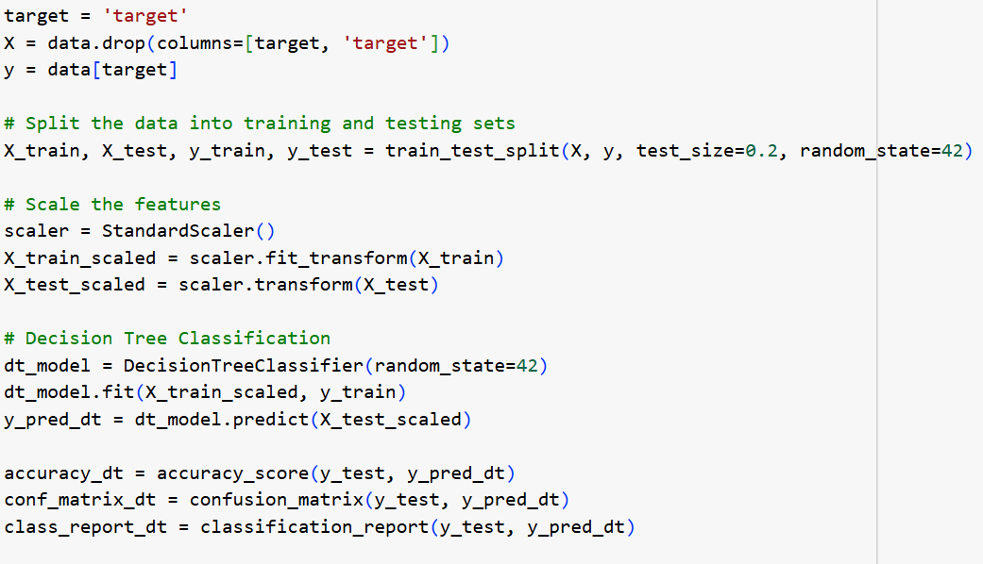
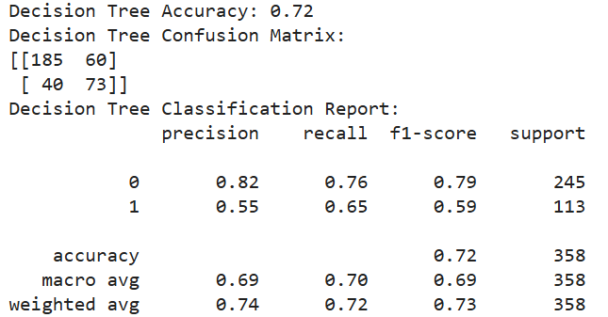

DECISION TREE
A model that splits the data into branches to make predictions. It is easy to visualize and interpret.

Slide 16
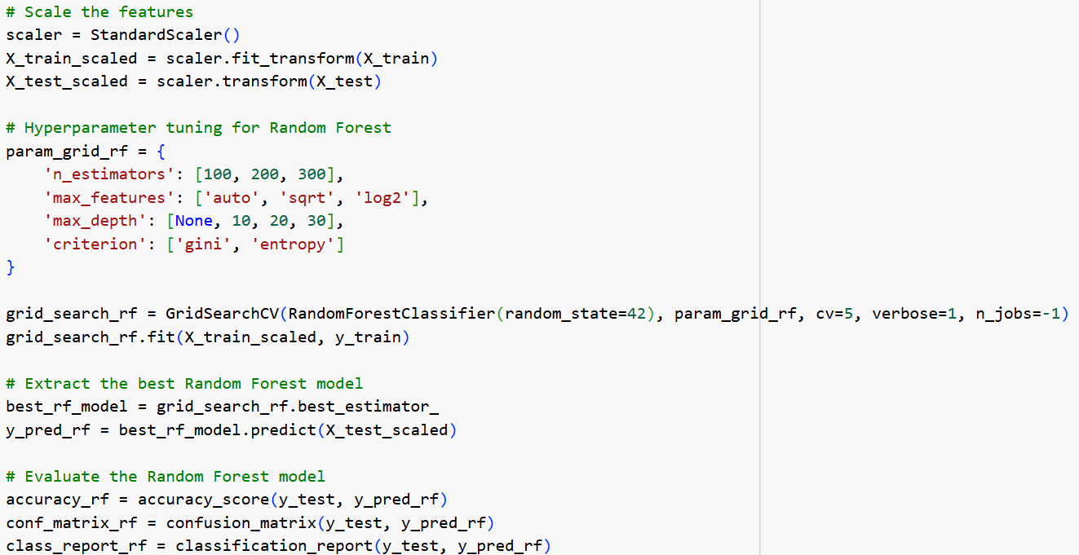
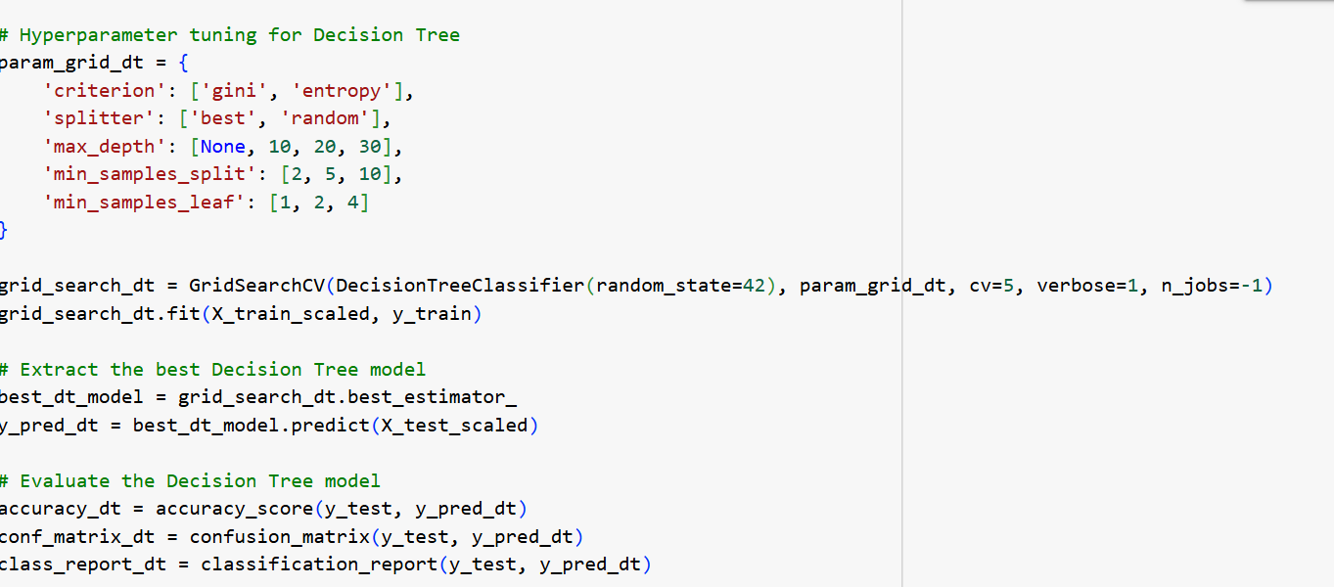
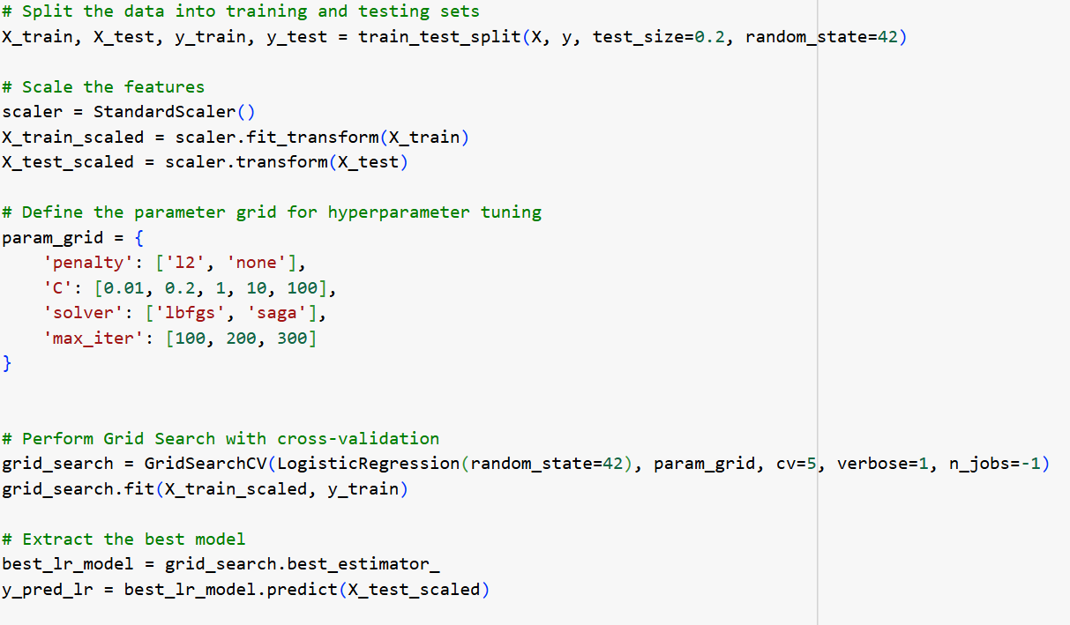
HYPERPARAMETER TUNING
Random forest – 80%
Decision Tree – 76%
Logistic regression – 79%
Hyperparameter tuning is the process of optimizing the parameters that are not learned from the data but set prior to the training process. Effective tuning can significantly enhance model performance.

Slide 17
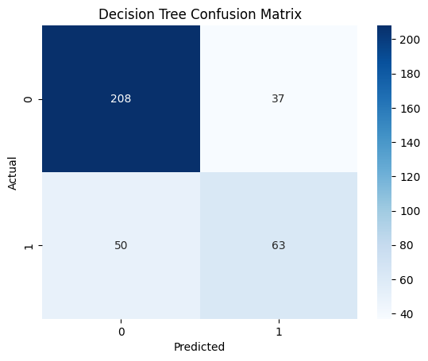


CONFUSION MATRIX
A confusion matrix is a tool used to evaluate the performance of a classification model. It provides a detailed breakdown of the model's predictions.

Slide 18
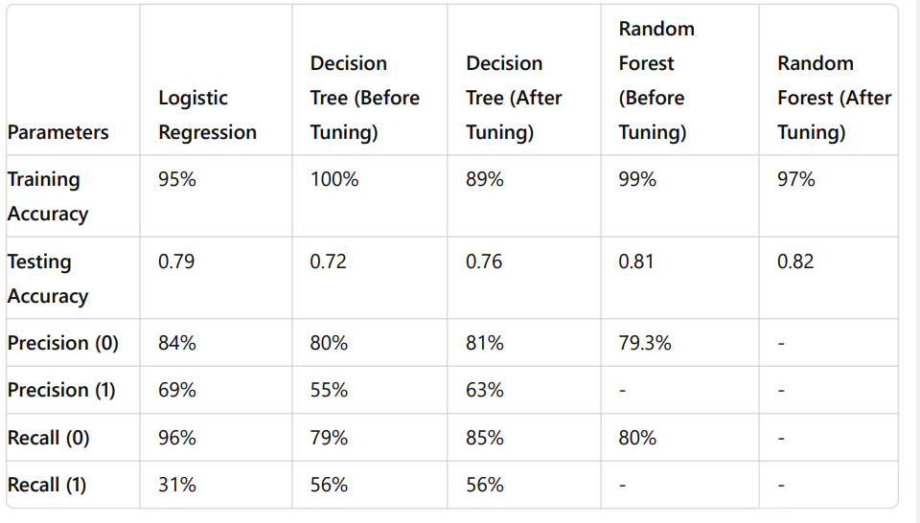
COMPARISON
Random Forests offer high accuracy by combining multiple decision trees. They are versatile and robust, handling various data types and reducing overfitting.

Slide 19
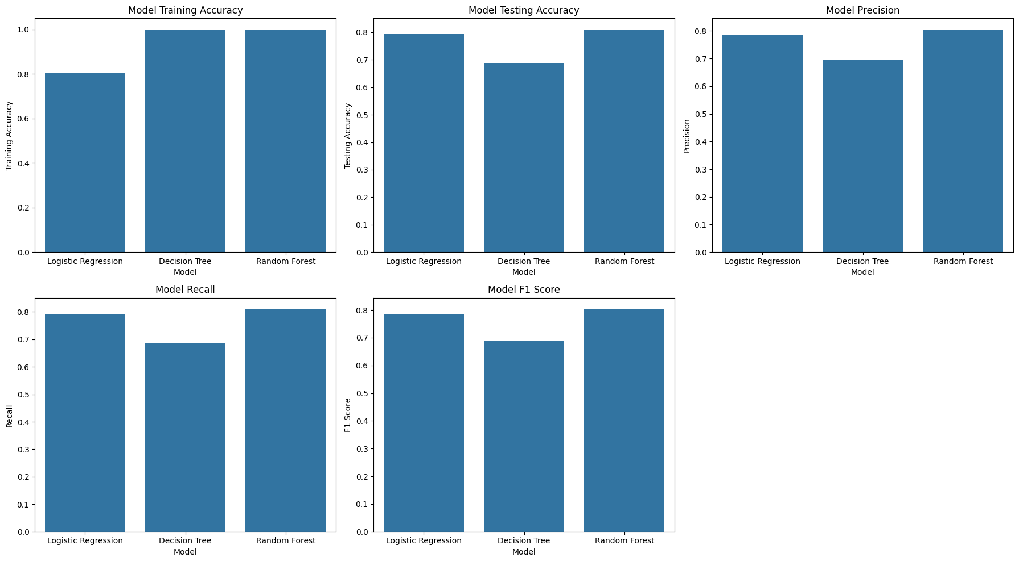
ACCURACY

Slide 20
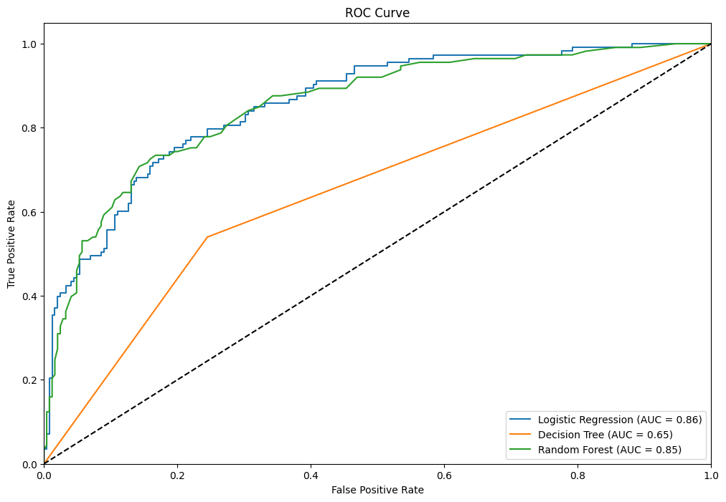
ROC Curve
The ROC (Receiver Operating Characteristic) curve is a graphical representation used to assess the performance of a binary classification model. It illustrates the trade-offs between the True Positive Rate (TPR) and the False Positive Rate (FPR) at various threshold settings.

Slide 21
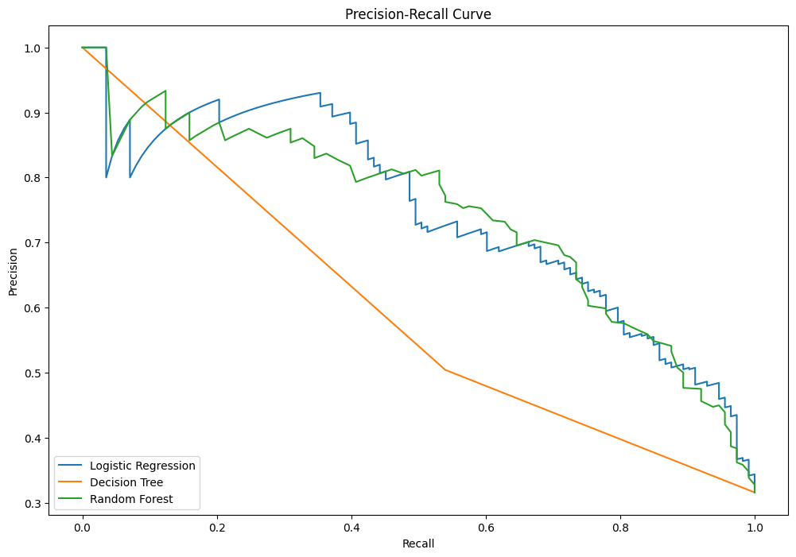
ROC Curve
The AUC represents the overall performance of the model. It is the area under the ROC curve and provides a single value that summarizes the model’s ability to discriminate between the positive and negative classes.

Slide 22


Conclusion
Accurately predicting telecom churn is crucial for retaining customers and sustaining business growth. By leveraging advanced machine learning techniques and continuously refining our models, we can effectively identify at-risk customers and implement targeted retention strategies, ultimately enhancing customer satisfaction and loyalty.

Slide 23
Thanks!

